Slide 1
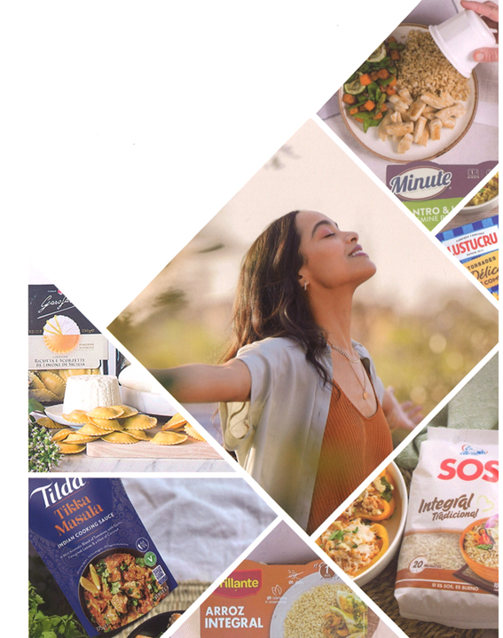
RESULTS Q1 2025

Slide 2
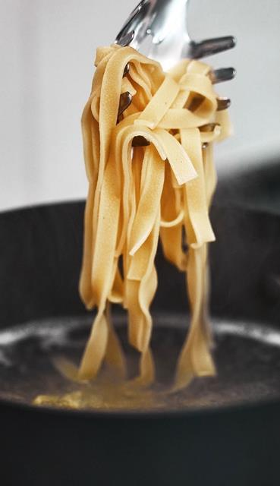
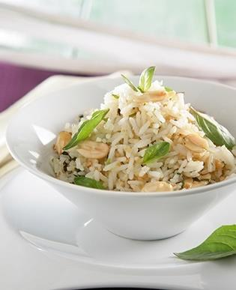


CONTENTS
INTRODUCTION
BUSINESS UNIT RESULTS Q1 2025
  2.1 Rice
  2.2 Pasta
CONSOLIDATED GROUP RESULTS Q1 2025
  3.1 P&L
  3.2 Debt Performance
CONCLUSION
CORPORATE CALENDAR 2025
CALCULATION OF ALTERNATIVE PERFORMANCE MEASURES
LEGAL DISCLAIMER

Slide 3
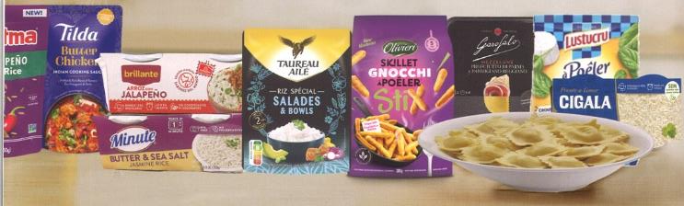

1. Introduction
Our positive business performance in the first quarter has delivered encouraging results, further consolidating our leadership position in the market. Branded sales continue to show solid growth, particularly within our higher value-added categories (microwave, gnocchi, premium fresh pasta, Tilda and Garofalo), although there has been a slight decline in industrial sales.
Rice prices are trending downwards, supported by favourable precipitation, strong harvests and the return of rice exports from India.
The tariffs recently announced by President Trump on imports from Thailand (36%), India (27%) and Europe (20%) have prompted us to accelerate deliveries of imported rice to the US. While we await the outcome of ongoing trade negotiations, we anticipate that the overall impact on our business will be less significant than for many of our competitors, thanks to our robust local manufacturing footprint and global supply chain.
In the pasta division raw material costs are mixed. Egg prices have risen sharply due to avian flu, while the cost of dairy products has also risen, both of which are impacting our fresh pasta business. Conversely, the price of semolina and potato flakes have remained stable, which is particularly relevant to our major gnocchi business.
3

Slide 4
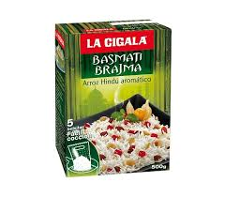

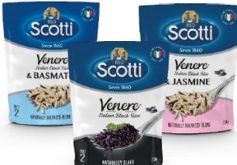
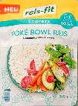

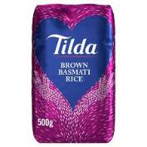
2.1.1 Rice Q1 2025
In Spain, raw material markets have continued to follow the high price trend seen in the previous year, particularly for pearled grains. However, this is expected to reverse in the coming months, as heavy rainfall has significantly improved reservoir levels across Spain. With irrigation reservoirs in the Guadalquivir basin at 52% capacity and those in the Guadiana at 70%, full sowing across Andalusia and Extremadura will now be possible.
The outlook is more bearish for international markets, driven by the reopening of rice exports from India and strong harvests in the Southern Cone. In Q1, we secured basmati purchases in India at lower prices than the previous campaign. However, due to our rice ageing policy, the benefits of these lower costs will not be noted until the summer.
In the US, raw material prices are also low and remain below the previous campaign's levels. This is primarily due to two factors: (i) the difficulty of exporting amidst strong competition from Asia, and (ii) the expectation of a planted area similar to that of 2024. Despite delays in sowing caused by heavy spring rains and a significant carry-over from the previous campaign, we do not anticipate any major impact on prices.
Tariff uncertainty has led us to accelerate imports of fragrant rice varieties (basmati and jasmine), as well as microwave products, in order to mitigate potential impacts while capacity expansion investments in the US are being finalised.
In other regions, lower prices have also encouraged long positions, resulting in an increase in working capital.
Our brands have performed well across markets, particularly in microwave products and aromatic rice varieties. The main exception is France, where promotional activity dropped off following barcode changes across our portfolio – an adjustment linked to the conclusion of transitional services, following the sale of Panzani.
4

Slide 5
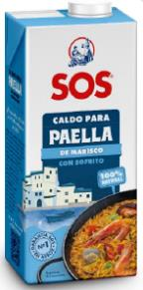

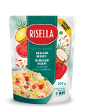
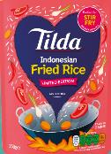

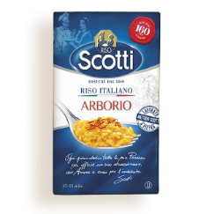

2.1.2 Rice Q1 2025
The rice Division sales fell by 2.9% due to deflation and a reduction in certain non-branded sales.
We continue to step up advertising investment in support of new launches for all of our brands. As a result, advertising investment increased by 5.7% year on year to EUR16.7 million.
In spite of a drop in sales and an increase in advertising investment, EBITDA-A grew 5.3% to EUR87.3 million; growing 3.7% in terms of CAGR 25/23. Currency exchange had an impact of EUR1.3 million on this figure.
Operating profit grew 5.4% to EUR68.3 million.
5

Slide 6
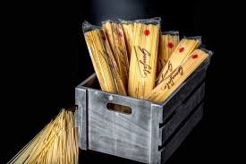
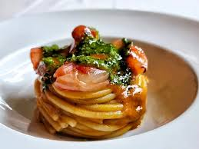
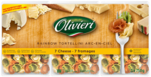
2.2.1 Pasta Q1 2025
In both France and Canada, fresh pasta sales have performed well, supported by the success of recent product launches and the completion of capacity expansion at our Lyon facility during Q1.
Advertising and promotional spend remained in line with the same period last year, amidst reduced competitive pressure in the French fresh pasta market.
There has been a sharp rise in egg prices due to avian flu outbreaks, with a more modest increase in dairy products. These increases have had a greater impact in North America, particularly affecting our fresh pasta business in Canada. As a result – and in light of the Canadian dollar's depreciation against the US dollar – Olivieri is currently negotiating price increases.
In France, Lustucru has been less exposed to egg price fluctuations. For this subsidiary, the more relevant cost factor is the price of potato flakes, a key raw material for gnocchi, which has remained stable.
Globally, Garofalo-branded sales increased by 11.5% in the quarter.
To further strengthen Garofalo's premium position, we are preparing to launch a high-protein pasta, which will stand out from the competition in this category in terms of quality, texture and taste.
6

Slide 7
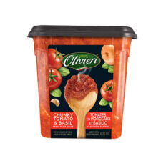
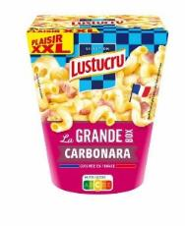
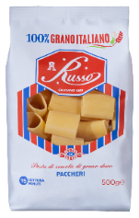
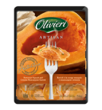
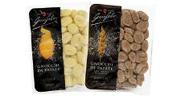
2.2.2 Pasta Q1 2025
Turnover grew 1.7% to EUR181.2 million, thanks to increased volumes as mentioned above.
Advertising investment remained at EUR9.5 million. We continue to support new product launches.
The Division's EBITDA-A fell 4.8% to EUR29.5 million. This was caused by a slight consumer price adjustment in Garofalo. The exchange rate had almost no impact on these results.
Operating Profit fell 4.1% to EUR20.7 million.
7

Slide 8
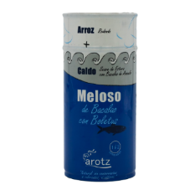
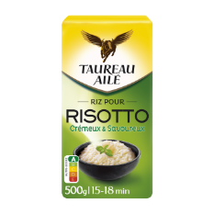


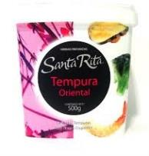

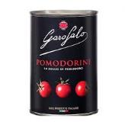
3.1 P&L Q1 2025
The consolidated sales figure fell by 1.8% to EUR791.9 million.
EBITDA-A grew by 2.2% to EUR112.1 million, beating our record result from Q1 2024 and achieving a CAGR 23/25 of 7.9%. The EBITDA-A margin increased to 14.2%. Currency had an impact of EUR1.3 million on this figure.
Net Profit decreased by 6.4% to EUR50.3 million, due to exchange rate differences from the devaluation of the US dollar, as well as higher interest costs following the refinancing of bank debt at the end of 2024. While the new terms remain very favourable, they are not as advantageous as those enjoyed over the past three years.
ROCE-A continued to improve, reaching 13.7%. This equates to an increase of 0.3 p.p. vs 2024 (3.1 p.p. vs 2023).
EUR Thous. | Q1 2023 | Q1 2024 | Q1 2025 | 24/25 | CAGR 23/25
Sales | 810,151 | 806,598 | 791,961 | -1.8% | -1.1%
Advertising | 23,384 | 25,365 | 26,243 | 3.5% | 5.9%
EBITDA-A | 96,314 | 109,654 | 112,110 | 2.2% | 7.9%
EBITDA-A Margin | 11.9% | 13.6% | 14.2% | - | -
Ebit-A | 71,679 | 83,652 | 84,787 | 1.4% | 8.8%
Operating Profit | 68,928 | 81,679 | 83,970 | 2.8% | 10.4%
Pre-tax Profit | 63,950 | 80,696 | 77,663 | -3.8% | 10.2%
Net Profit | 43,802 | 53,732 | 50,301 | -6.4% | 7.2%
ROCE-A | 10.6% | 13.4% | 13.7% | - | -
*Net profit attributed to the parent company
8

Slide 9

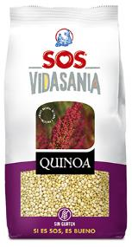
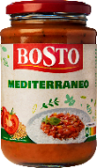
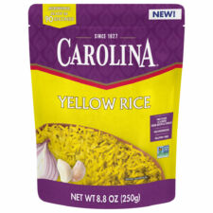

3.2 Debt Performance
At 31 March, net debt amounted to EUR599.3 million, EUR6.1 million more than at year-end 2024.
The change in Working Capital had an impact of EUR46.0 million on debt levels.
Corporate income tax in Q1 2025 stood at EUR19.86 million.
CAPEX investments amounted to EUR29.9 million.
EUR Thous. | 31-mar-23 | 31 Dec 23 | 31-mar-24 | 31 Dec 24 | 31-mar-25 | 24/25 | CAGR 23/25
Net Debt | 743,912 | 570,404 | 507,015 | 593,174 | 599,303 | 18.2% | -10.2%
Average net debt | 702,555 | 831,747 | 621,717 | 529,868 | 544,431 | -12.4% | -12.0%
Equity | 2,190,568 | 2,185,159 | 2,268,969 | 2,329,616 | 2,329,998 | 2.7% | 3.1%
ND Leverage | 34.0% | 26.1% | 22.3% | 25.5% | 25.7%
AND Leverage | 32.1% | 38.1% | 27.4% | 22.7% | 23.4%
x EBITDA-A (ND) |  | 1.5 |  | 1.4
x EBITDA-A (AND) |  | 2.1 |  | 1.3
9

Slide 10

4. Conclusion
We returned to EBITDA-A growth in Q1 2025, surpassing the record performance achieved in Q1 2024.
Heavy rainfall in Spain has eased drought concerns, enabling full sowing in Spain.
Our significant investments in microwave products, instant rice, fresh pasta and gnocchi in recent years are beginning to bear fruit, delivering strong growth and improved returns.
We are very pleased with the performance of our brands, which are strengthening their positions in most markets, particularly in the higher value-added categories.
10

Slide 11


5. Corporate Calendar
As part of Ebro’s commitment to complete transparency, below we provide our Corporate Calendar for 2025:
25 February | Presentation of YE 2024 Results
1 April | Four-month payment of ordinary dividend (EUR0.23/share)
30 April | Presentation of Q1 2025 results
30 June | Four-month payment of ordinary dividend (EUR0.23/share)
29 July | Presentation of H1 2025 results
1 October | Four-month payment of ordinary dividend (EUR0.23/share)
29 October | Presentation of 9M25 results

Slide 12
6. Calculation of Alternative Performance Measures
According to the guidelines set by the European Securities and Markets Authority (ESMA), the following is a list of the indicators used in this report. These indicators are currently and consistently used by the Group to describe its business performance and their definitions have not been altered:
  EBITDA-A. Earnings before interest, taxes, depreciation and amortisation, excluding results considered as extraordinary or non-recurring (essentially profit earned from transactions relating to the Group’s fixed assets, industrial restructuring costs, results from or provisions for lawsuits, etc.). EBITDA-A is calculated consistently with prior-year EBITDA-A.
  EBIT-A is calculated by subtracting the year's amortisations and depreciations from EBITDA-A. EBIT-A is calculated consistently with prior-year EBIT-A.
  CAPEX. Capital expenditure - payments for investment in production related fixed assets.
  Net Debt:
  (Average) Net Debt: Average net debt refers to the 12-month moving average based on previous net debt.
  (Average) Working Capital: 12-month moving average of the sum of inventories, trade receivables and provision of services, other receivables less trade payables and other current payables.
  Capital Employed (average). 12-month moving average of the sum of intangible assets, property, plant and equipment and working capital.
  ROCE-A: Ratio of the average profit/loss after depreciation/amortisation and before tax for the last 12-month period (excluding extraordinary and non-recurring items) divided by the average capital employed, as previously defined. ROCE-A is calculated consistently with prior-year ROCE.
 |  | 31/03/2023 |  | 31/03/2024 |  | 31/03/2025
EBITDA(A) |  | 96,314 |  | 109,654 |  | 112,110
Provisions for depreciation/amortisation |  | (24,635) |  | (26,002) |  | (27,323)
EBIT(A) |  | 71,679 |  | 83,652 |  | 84,787
Non-recurring income |  | 350 |  | 155 |  | 430
Non-recurring costs |  | (3,101) |  | (2,128) |  | (1,247)
OPERATING PROFIT |  | 68,928 |  | 81,679 |  | 83,970
 |  | 31/03/2023 |  | 31/03/2024 |  | 31/03/2025
(+) Non-current financial liabilities |  | 540,811 |  | 175,320 |  | 199,192
(+) Other current financial liabilities |  | 441,601 |  | 742,014 |  | 685,094
(+) Financial liabilities available for sale |  | 0 |  | 0 |  | 0
(-) Loans to associates |  | (1,122) |  | (1,122) |  | (1,122)
(-) Sum of security deposits payable |  | (676) |  | (500) |  | (43)
(-) Cash and cash equivalents |  | (238,158) |  | (408,496) |  | (286,929)
(-) Derivatives – assets |  | (1,766) |  | (592) |  | (896)
(+) Derivatives – liabilities |  | 3,222 |  | 391 |  | 4,007
TOTAL NET DEBT |  | 743,912 |  | 507,015 |  | 599,303
12

Slide 13
7. Legal Disclaimer
This presentation contains our true understanding to date of estimates on the future growth in the different business lines and the global business, market share, financial results and other aspects of business activity and the positioning of the Company. All the data included in this report have been put together according to International Accounting Standards (IAS). The information included herein does not represent a guarantee of any future actions that maybe taken and it entails risks and uncertainty. The actual results may be materially different from the ones stated in our estimates as a result of various factors.
Analysts and investors should not rely on these estimates, which only cover up to the date of this presentation. Ebro Foods does not assume any obligation to publicly report the results of any review of these estimates that may be carried out to reflect events and circumstances occurring after the date of this presentation – including but not limited to – changes in Ebro Foods business or its acquisitions strategy, or to reflect unforeseen events. We encourage analysts and investors to consult the Company’s Annual Report, as well as the documents filed with the Authorities and more specifically with the Spanish National Securities Markets Commission (CNMV).
The main risks and uncertainties affecting the Group’s business are the same as those included in the Consolidated Annual Accounts and the Management Report for the year ending 31 December 2024, which is available at www.ebrofoods.es. We believe that there have been no significant changes during this financial year. The Group still has some exposure to the raw materials markets and to passing on changes in prices to its customers. Likewise, there is certain exposure to fluctuations in the exchange rate, especially the dollar, and changes in interest rates.
13

